Slide 1








DATA ANALYSIS
Module 4: Statistic for Analytics
Regression
Fundamentals
Topic 3 of 5
Notes:
1.7.2013
‹#›

Slide 2

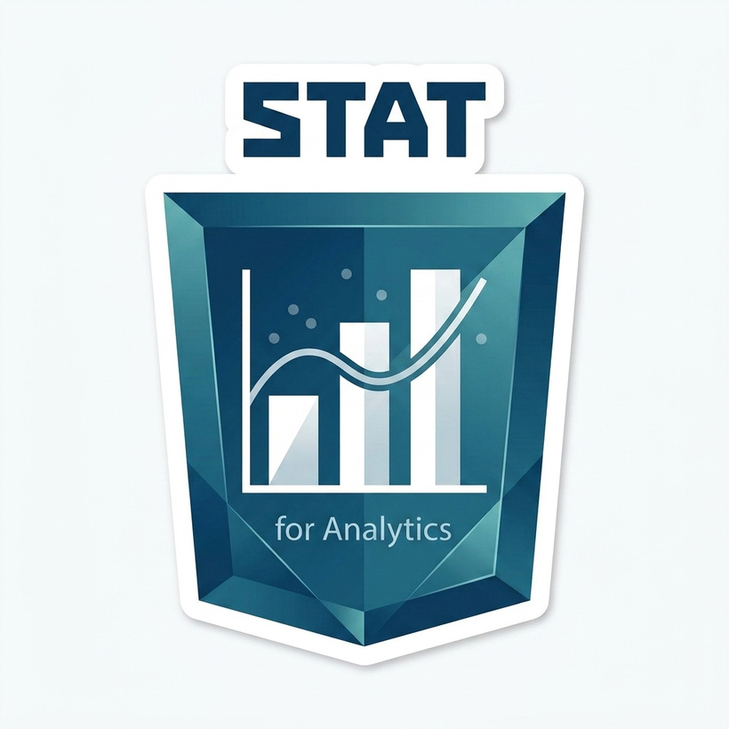


Learning outcome
By the end of this topic, you can...
1. Fit a Regression Line
Fit a simple linear regression line to a dataset in Excel using built-in statistical functions ( and ) .
2. Interpret Parameters
Interpret the slope and intercept of a regression line accurately using clear, plain business language for decision-makers.
3. Interpret R-Squared (R²)
Interpret R² as a direct measure of how much variation in the business outcome your statistical model actually explains.
4. State Model Limits
State the limits of regression models, including the severe dangers of extrapolation and forcing a straight line onto a curved relationship.
Notes:
1.7.2013
1.7.2013
‹#›
‹#›

Slide 3
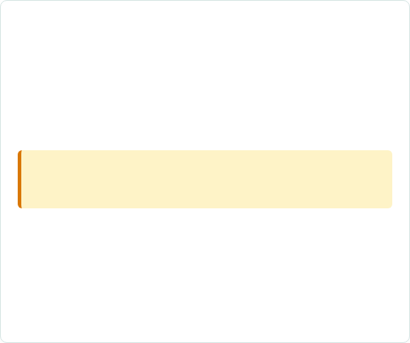

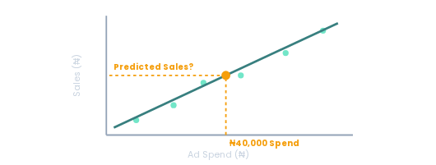
If we spend ₦40,000 tomorrow, what sales can we expect?
The Ikeja Branch Challenge
The Ikeja branch manager liked Topic 4.2's finding that ad spend and daily sales move together ($r \approx 0.78$).
Now, they want something far more practical than "they are related":
Predicting From Data
"If I commit to spending exactly ₦40,000 on ads tomorrow, what sales figure should I plan around?"
Correlation alone cannot answer this: It shows variables move together, but not by how much, or what value to expect.
Regression is built for this: Draws the best-fitting straight line to make specific numeric predictions.
Notes:
1.7.2013
1.7.2013
‹#›
‹#›

Slide 4
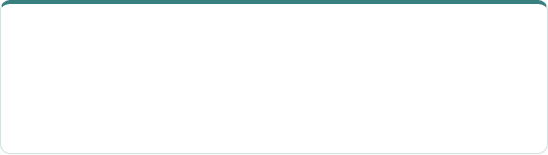
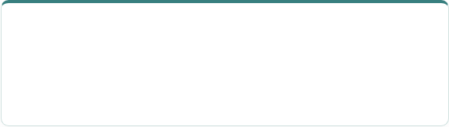

What is a Regression Line?
A regression line is the single straight line that best fits a scatter plot of two variables, positioned so that it is, on average, as close as possible to every data dot.
Dependent Variable ($Y$)
Independent Variable ($X$)
What you are trying to predict (e.g., Daily Sales).
What you know / input factor (e.g., Marketing Spend).
Plotted on the vertical axis (Y-axis).
Plotted on the horizontal axis (X-axis).
Every straight line can be written in the same simple form:
Sales = Intercept + (Slope × Marketing Spend)
This is the exact same concept as y = mx + c from school mathematics, relabelled with practical business terms!
Notes:
1.7.2013
1.7.2013
‹#›
‹#›

Slide 5


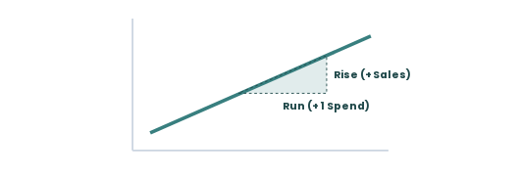


The Slope: Definition & Excel Formula
What is the Slope?
The slope measures how much the dependent variable (sales) changes, on average, for every one-unit increase in the independent variable (spend).
Visualizing Slope (Rise / Run)
CRITICAL ORDER: Enter (Sales) first , then (Spend) second!
Calculates: The steepness and direction of the line. Positive slope = sales rise with spend; negative slope = sales fall with spend.
Notes:
1.7.2013
1.7.2013
‹#›
‹#›

Slide 6




The Slope: Business Interpretation
Analyst Usage
Plain Language Translation
When an analyst uses it:
"For every extra ₦1 spent on ads, daily sales tend to rise by about ₦3.47, on average, based on the days tested."
To quantify a relationship already confirmed with correlation, turning "they move together" into "here is roughly how much."
This describes average revenue trends across many days, not a guarantee for a single day.
3.47
Calculated Slope Example
Not Profit: This calculates sales revenue, not net profit (cost of goods sold is separate).
Notes:
1.7.2013
1.7.2013
‹#›
‹#›

Slide 7

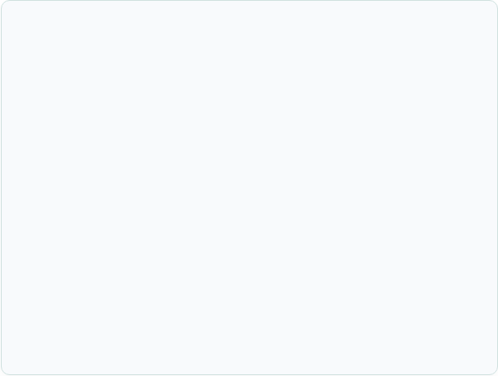
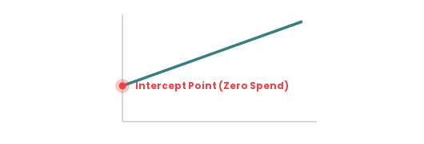

The Intercept: Baseline Starting Point
What is the Intercept?
The intercept is the predicted value of the dependent variable (sales) when the independent variable (spend) is exactly zero.
Visualizing the Intercept (X = 0)
Uses the exact same two ranges ( , ) in the exact same order.
Calculates: Where the regression line crosses the vertical axis. the baseline prediction before accounting for any spend at all
Notes:
1.7.2013
1.7.2013
‹#›
‹#›

Slide 8

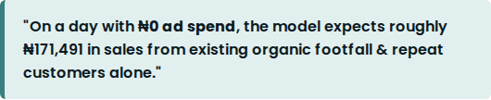
The Intercept: Business Interpretation
Interpretation Example
Cautionary Analyst Note
In our Ikeja branch analysis, the calculated intercept is approximately ₦171,491.
Treat baseline intercept figures with professional caution:
It is a mathematical starting point, not necessarily a day that was ever actually observed in historical test data.
In some financial models, intercepts can yield negative numbers—a natural mathematical artifact that does not invalidate the model.
Complete Formula Assembly
Notes:
1.7.2013
1.7.2013
‹#›
‹#›

Slide 9


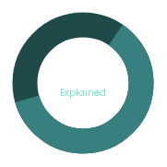

R-Squared (R²): How Much Does Model Explain?
What is R-Squared?
R-squared ($R^2$) measures how much of the variation in the dependent variable (sales) is explained by the regression model, on a scale from 0 to 1 (or 0% to 100%).
Decomposing Sales Variance
Calculates: the proportion of the ups and downs in sales that spend, through this straight line, actually accounts for.
Purpose: Judges how much confidence to place in the modeol, separately from whether the slope's direction makes sense
Notes:
1.7.2013
1.7.2013
‹#›
‹#›

Slide 10


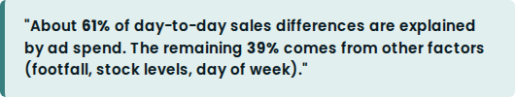

R-Squared (R²): Business Meaning & Shortcut
Business Interpretation
Mathematical Shortcut
An R² value of 0.61 means:
For simple two-variable regression, R² is simply the correlation coefficient r, squared!
r = 0.78 ⟹ R² = (0.78)² ≈ 0.61
Remember in Topic 4.2's r = 0.78
Gives executives realistic expectations rather than claiming 100% perfection.
Notes:
1.7.2013
1.7.2013
‹#›
‹#›

Slide 11


The Limits of a Regression Model
A regression model is only trustworthy within the range of data from which it was built. Beware of two major analytical traps:
1. Extrapolation Danger
2. Forcing Lines on Curves
Predicting far beyond tested spend ranges.
Assuming non-linear data is linear.
If tested spend is ₦8,500 to ₦69,500, predicting at ₦150,000 spend is a wild guess dressed up as a calculation. You have no data out there!
Relationships like floor staffing often hit diminishing returns (curving downwards). A straight line produces poor, biased predictions at both ends.
Professional Analyst Habit
ALWAYS plot the scatter plot before trusting R²! An R² number can look high while the visual shape reveals a curved pattern that invalidates linear regression.
Notes:
1.7.2013
1.7.2013
‹#›
‹#›

Slide 12



Aduke Stores (Ikeja): Live Excel Execution
Ikeja 24-Day Marketing Dataset
Resulting Prediction Formula
Using daily spend (X, C5:C28) and sales (Y, D5:D28):
Sales = 171,491 + (3.47 × Spend)
Notes:
1.7.2013
1.7.2013
‹#›
‹#›

Slide 13



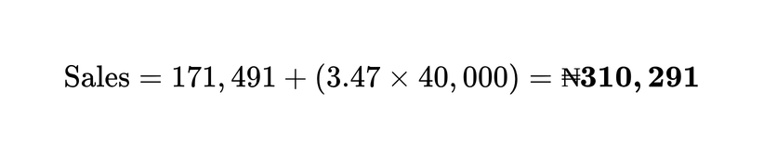
Aduke Stores: Answering ₦40,000 Question
Step-by-Step Calculation
Executive Business Statement
Apply ₦40,000 to our regression formula:
What WE WOULD NOT DO: Predict sales for ₦150,000 spend (Extrapolation Trap).
Validity Check: ₦40,000 falls comfortably within tested spend range (₦8,584 to ₦69,535).
Verdict: Valid, evidence-based estimation!
Notes:
1.7.2013
1.7.2013
‹#›
‹#›

Slide 14




Your Turn: Is Yaba's Line Worth Trusting?
Activity Task (6 Mins)
Worksheet Mockup
Open Yaba branch test data in lab pack (same dataset from Topic 4.2).
Your Calculated Metrics:
1. Calculate: Slope, Intercept, and R² in Excel.
Slope: _____ | Intercept: _____ | R²: _____
2. Decide: Should Yaba's manager use this line to plan spend? Justify using R².
Your 1-Sentence Recommendation:
3. Write: One sentence recommendation to Yaba's manager.
Notes:
1.7.2013
1.7.2013
‹#›
‹#›

Slide 15

Key Takeaways
Key Capabilities Mastered
Fit a regression line in Excel using and , and write standard prediction formulas.
Up Next:
Hypothesis testing
Explain slope and intercept in plain, crisp business language.
Interpret R² as the share of outcome explained and link it back to correlation .
Recognize model limits: extrapolation risks & non-linear curves.
Notes:
1.7.2013
1.7.2013
‹#›
‹#›

Slide 16



Up Next: Topic 4.4 — Hypothesis Testing
The Bridge to Topic 4.4
Action Items Before Next Session
Today you learned to quantify relationships and predict outcomes.
Complete Topic 4.3 Lab Exercises (Guided & Semi-Guided).
Regression models describe what data shows, but don't tell you if observed differences are real or random noise.
Complete LMS Practice Questions on publica.academy.
Tackle the Independent Lab Tier (introduces a non-linear dataset!).
Notes:
1.7.2013
1.7.2013
‹#›
‹#›

